Slide 1
Gaja Šubic 9.b
CHICKEN GIRLS

Slide 2
Chicken Girls tells the story of middle school student Rhyme McAdams and her friends, Ellie, Quinn, and Kayla – known as "The Chicken Girls" – who have been dancing together forever. The show follows the girls as they navigate dance, friendship, crushes, and learning how to grow up.
8 sezon
It‘s Drama, it was released 2017 on Brat TV
Chicken Girls is about love and drama.

Slide 3
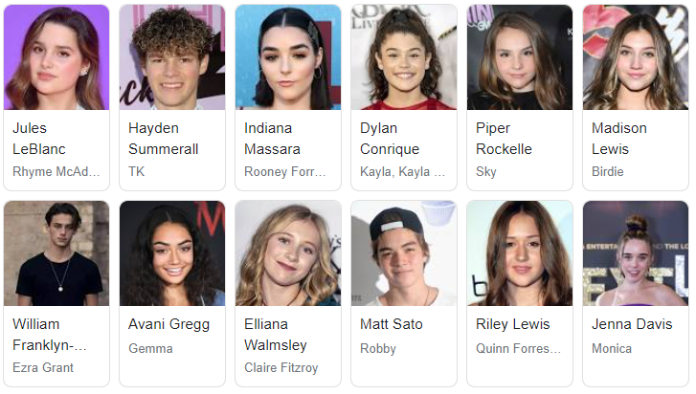
Actors:
Brooke Butler (Ellie)
Annie/Jules LeBlanc (Rhyme)
Hayley LeBlanc (Harmony)
Hayden Summerall (TK)
Dylan Conrique (Kayla)
Indidana Massara (Rooney)
Madison Lewis (Birdie)
Riley Lewis (Quinn)

Slide 4
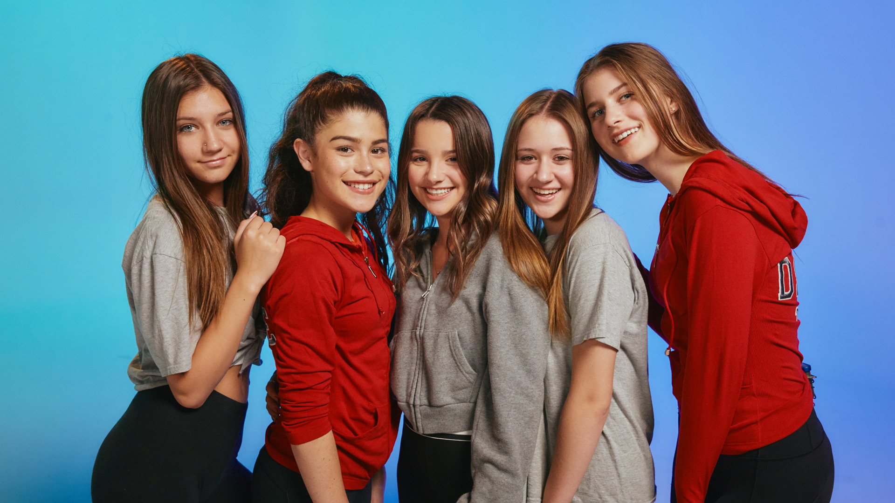
Chicken girls:
Rhyme
Kayla
Ellie
Birdie
Quinn

